Slide 1
Chatbot for eGovernance
PIP104 University Project-II
Final Review
Batch Number: G14 - 7ISE2
Roll Number | Student Name
20201ISE0055 | Vikram
20201ISE0085 | Shreyas S
20201ISE0054 | Thejas V
20201ISE0091 | Tushar Tiwari
Under the Supervision of,
Ms. Monisha Gupta
Professor
School of Computer Science & Engineering
Presidency University

Slide 2
Introduction
In an era of rapidly evolving digital services and government initiatives, our project embarks on a mission to empower citizens with a groundbreaking chatbot that consolidates vital information on government-sponsored loans and insurance schemes from multiple sources. Leveraging cutting-edge technologies and natural language processing, our interactive chatbot serves as a single, accessible gateway to essential financial assistance programs. Drawing data from reputable sources including NABARD and RBI, this innovation not only simplifies access but also augments user experience, enabling individuals to seamlessly discover, understand, and benefit from a spectrum of governmental financial offerings. With the Mega Bot, we aim to revolutionize how individuals interact with and access government services, enhancing financial literacy and promoting financial inclusivity.

Slide 3
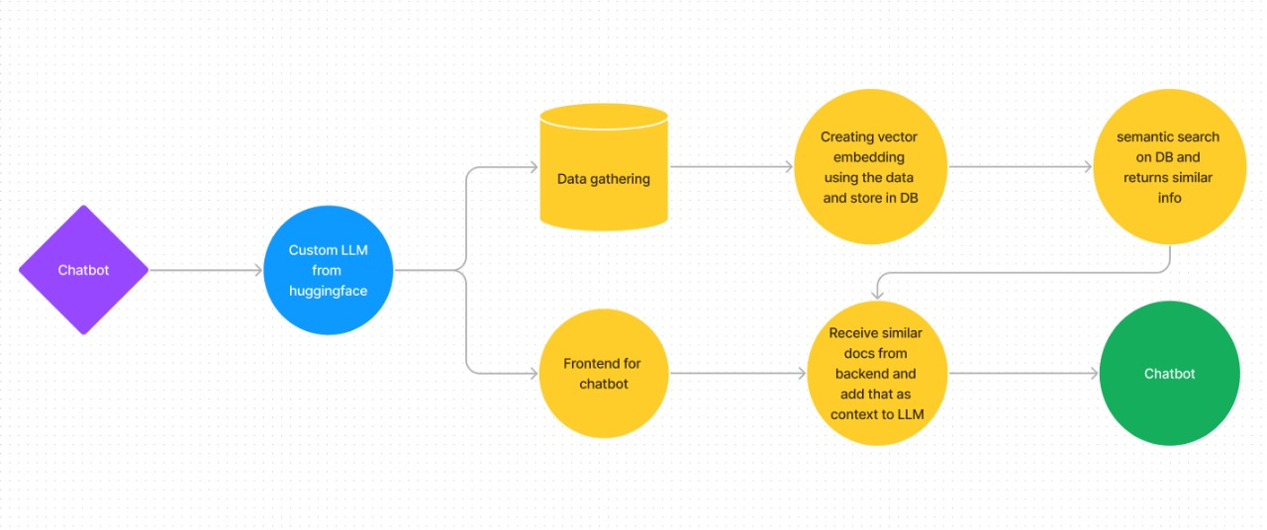
Flowchart

Slide 4
Literature Review
Within the realm of machine learning, the utilization of Data Mining represents a pivotal concept in uncovering valuable insights from extensive datasets. Deep Learning, a technique integral to this domain, encompasses the analysis of vast data sets from diverse angles to extract meaningful information. This technique amalgamates elements from artificial intelligence, statistics, probability, machine learning, deep learning, and database system technologies. The holistic process of Deep Learning involves several key stages:
Data Collection: Gathering extensive datasets from various sources relevant to the domain of study.
Selection and Cleaning: Identifying pertinent data and ensuring its quality by eliminating inconsistencies and errors.
Handling Missing Values: Addressing and managing absent or incomplete data points within the dataset.
Transformation: Converting raw data into a format suitable for analysis and mining.
Mining and Pattern Evaluation: Employing sophisticated algorithms to detect patterns and insights within the dataset.
Knowledge Visualization: Presenting the discovered knowledge and insights in a comprehensible manner, aiding in understanding and decision-making processes.

Slide 5
Literature Review - Cont.
Title: A survey on providing customer and public administration based services using AI: chatbot
Authors: Krishna Kumar Nirala, Nikhil Kumar Singh & Vinay Shivshanker Purani
Year: 2022
Challenges:
The paper discusses challenges in developing efficient chatbot applications, focusing on issues such as the lack of training data for machine learning-based systems, poor conversational understanding in ML chatbots, and the need for significant improvements in grammatical errors, language structure, sentiment analysis, and more. It emphasizes the potential of deep learning algorithms to address these challenges but acknowledges the requirements for substantial data and time for natural response generation.
Motivation:
The primary motivation of the review paper is to explore AI-Chatbots, specifically in the context of customer and public administration services. It highlights the limited work in developing public administration service-based chatbots and outlines the goals of the review, including categorizing AI-Chatbots, examining their architecture and evolution, assessing performance measurements, and discussing the limited research on public administration-focused chatbots.

Slide 6
Literature Review - Contd.
Title: Natural Language Processing for Government Policy Intelligence
Author: Michael Stankosky and Prasad S. Chaudhari
Year: 2019
Objectives:
Analysis of NLP in Government Policies: The paper aimed to explore the potential applications of Natural Language Processing (NLP) techniques in the domain of government policy analysis and understanding.
Challenges Faced:
The vast amount of unstructured data generated by government agencies. The difficulty of extracting meaningful insights from this data. The lack of effective tools for analyzing and understanding policy-related text
Data Availability: Availability and access to comprehensive and standardized government policy datasets posed a challenge for effective NLP-driven analysis.
Semantic Understanding: Ensuring accurate semantic understanding and contextual interpretation of policy documents could have been a significant challenge.
Furthermore, the authors discuss the significance of NLP in aiding policymakers, government agencies, and researchers in gleaning actionable insights from vast repositories of policy-related texts. Insights garnered from this paper encompass the transformative impact of NLP in enhancing the comprehension, analysis, and decision-making processes concerning government policies.
The paper also highlights case studies or examples showcasing successful implementations of NLP techniques in policy intelligence, emphasizing the potential benefits and implications of such applications within the governmental landscape.

Slide 7
Literature Review - Contd.
Title: Chatbots: Are they Really Useful?
Author: Bayan Abu Shawar, Eric Atwell
Year: 2018
A Chatbot as Information Retrieval Tool:
Information Retrieval Beyond Education:
Chatbots in Social Theory Learning and Telecommunications:
Chatbots in Yellow Pages Information Retrieval:
Chatbots in Medical Education:

Slide 8
Advantages of existing methods:
Information Availability:
Current methods provide access to a wide array of information on government schemes and initiatives albeit scattered in nature (making it difficult to access)
User Engagement:
Some existing platforms offer user interaction, albeit limited, allowing users to explore and gather basic information.
Established Platforms:
Advantage: There are established government websites and databases that serve as sources of information for citizens.
Manual Assistance:
In some cases, citizens can seek manual assistance from government offices or personnel for information on schemes.

Slide 9
Disadvantages of existing methods:
Information Fragmentation:
Existing methods often suffer from fragmented information sources, making it challenging for users to access comprehensive and consolidated data.
Limited Accessibility:
Many platforms lack user-friendly interfaces, hindering easy access to vital information for a broader audience.
Outdated Information:
The static nature of some platforms results in outdated or obsolete information, leading to potential misinformation for users.
Complexity and Redundancy:
Government websites or databases might be complex to navigate, leading to redundancy in information or difficulty in finding relevant details.
Lack of Personalization:
Existing methods often lack personalized assistance or recommendations tailored to individual needs and preferences.

Slide 10
Proposed Method
Utilize GPT Model: Start by integrating an open-source GPT (Generative Pre-trained Transformer) model to enable conversational capabilities for the chatbot.
Connect with Langchain: Integrate Langchain, a platform that facilitates connectivity with data sources like RBI and NABARD. This connection enables the chatbot to pull information dynamically.
Data Source Integration: Leverage Langchain to connect with RBI and NABARD databases, allowing the chatbot to access and retrieve real-time data regarding government-sponsored loans and insurance schemes.
User-Friendly Interaction: Design the chatbot interface to engage users in a friendly and interactive manner, enabling them to ask questions and seek information effortlessly.

Slide 11
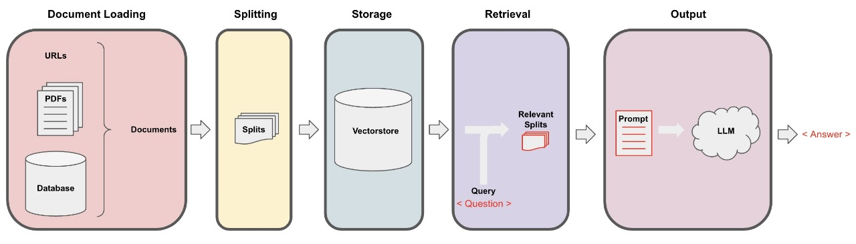
ChatBot - System Architecture

Slide 12
Objectives
Through this project we aim to create
Coherent source of information
User-Friendly Interaction
Accurate and Reliable Information
Customized Recommendations
Future-Proofing E-Governance

Slide 13
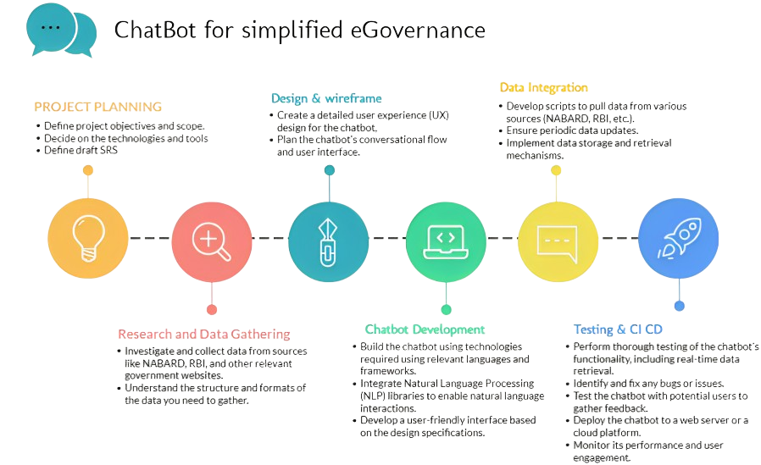
Project Phases

Slide 14
Timeline of Project
Sl. No | Review | Date | Scheduled Task
1 | Review - 0 | 09-10-23 to 13-10-23 | Initial Project Planning and Proposal Submission.
2 | Review - 1 | 06-11-23 to 10-11-23 | Completion of Research and Data Gathering Phase.
3 | Review - 2 | 27-11-23 to 30-11-23 | Completion of Chatbot Development and User Interface Design
4 | Review - 3 | 26-12-23 to 30-12-23 | Testing, User Training, and Documentation.
5 | Final Viva Voce | 08-01-24 to 11-01-24 | Project Submission and Presentation for Evaluation.

Slide 15
Expected Outcomes
Functional Chatbot: Develop a robust chatbot with advanced NLP capabilities for user interaction.
Data Integration: Successfully integrate data from government sources for real-time and accurate information retrieval.
User-Friendly Interface: Create an easy-to-use interface for clear information delivery.
Empowering Users: Enable users to make informed decisions about government financial programs.
Efficiency for Government: Assist government agencies in efficient information dissemination and policy insights.

Slide 16
Conclusion
In developing Scheme Setu, we hope to create an advanced, user-friendly chatbot that simplifies access to government-sponsored schemes and financial programs. This project has successfully integrated data, enhanced user experiences, and contributed to both financial inclusion and government efficiency. The journey continues as we remain committed to improvement, security, and adaptability, ensuring Mega Bot's lasting impact in empowering individuals and driving economic growth.

Slide 17
References
Nirala, K. K., Singh, N., & Purani, V. S. (2022). A survey on providing customer and public administration based services using AI: chatbot. Multimedia Tools and Applications, 81(16), 22215–22246.
Webber, S. (2009). Virtual patient chatbot. In Proceedings of the 2009 AAAI Spring Symposium on Agents that Learn from Human Teachers (pp. 106-111).
Schumaker, R. P., Ginsburg, M., Chen, H., & Liu, Y. (2006). An evaluation of the chat and knowledge delivery components of a low-level dialog system: The AZ-ALICE experiment. Decision Support Systems, 42(2), 2236-2246.
Langchain (https://js.langchain.com/docs/modules/data_connection/document_loaders/)
Spacy for NLP
(https://spacy.io)
Papertyari for data source
(https://papertyari.com/government-schemes/)
RBI
(https://www.rbi.org.in/Scripts/Schemes.aspx)
NAPIX- Government schemes api (https://napix.gov.in/)

Slide 18
Thank You

